Slide 1
Discrete Math
Unit IV (PART-2) : Trees ( Refer T-1 )
Trees
Rooted Trees, Path Lenghs in Rooted Trees
Prefix Codes,
Spanning trees
Minimal Spanning Trees, Kristal's Algorithm
Prim’s Algorithm

Slide 2
Unit IV : Trees
Objective :
To discuss the concepts associated with trees and cut-sets.
Introduction :
Tree can be defined as a graph with no cycles. Thus trees are special instances of graph. Then question arises why to study trees separately? But many real life problems can be solved by using trees. Examples include Binary Search Trees for searching, to derive minimum spanning trees which are used in laying a communication or highway network among cities. Decision trees in DSS etc.

Slide 3
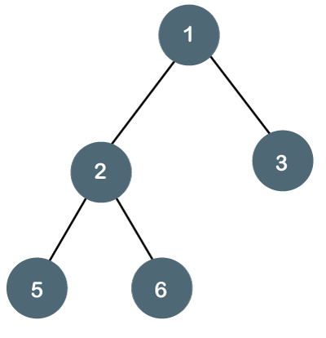
Terminology :
Tree : A tree is defined as a connected (undirected) graph that contains no circuit.
Leaf node or Terminal Node : A vertex of degree one in a tree is called a leaf or terminal node.
in given tree node 5,6,3 are leaf nodes.
Branch node or Internal Node : A vertex of degree larger than one is called a branch or internal node.
In given tree node 2 is internal node or branch node.

Slide 4
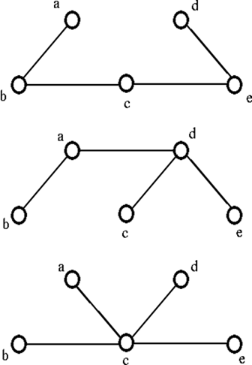
Terminology :
Forest : A collection of disjoint trees is called a forest.

Slide 5
Unit IV : Trees
Properties of trees :
There is a unique path between every two vertices in a tree, since there are no circuits in a tree.
Number of edges in a tree is equal to one less than the number of vertices in a tree, since by Euler’s formula v – e + r = 2 = v - e + 1 i.e. v – e = 1
A tree with two or more nodes has at least two leaves
Equivalent definitions of a tree :
A graph in which there is a unique path between every pair of vertices is a tree.
A connected graph with e = v – 1 is a tree.
A graph with e = v – 1 that has no circuit is a tree

Slide 6
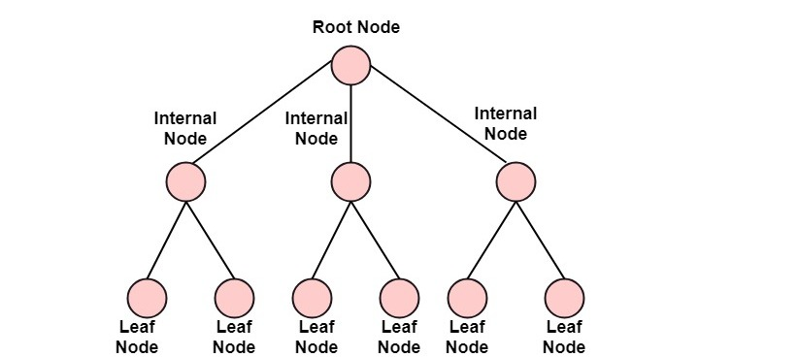
Unit IV : Trees
Rooted trees :
A directed tree is called a rooted tree if there is exactly one vertex whose incoming degree is zero and incoming degrees of all other vertices are 1.
The vertex with incoming degree o is called as the root of rooted tree.
Path length : The path length of a vertex in a rooted tree is defined to be the number of edges in the path from the root to the vertex.

Slide 7
Unit IV : Trees
Terminology :
Height of a tree : Height of a tree is defined to be the maximum of the path lengths in the tree. m-ary tree of height h has m^{h} leaves.
M-ary Tree :
Tree in which every internal node has at most “m” sons is called m-ary tree.
Binary Tree :
Every internal node has at most 2 sons
Full Binary Tree :
Every internal node has exactly 2 sons

Slide 8
Unit IV : Trees
Prefix codes :
Concept of path length is used to solve communication problem. Message length is reduced drastically.
Average number of occurrences per 1000 characters of text are predecided for each alphabet. i.e. weights
Huffman code is used to construct an optimal binary tree for a given set of weights for each alphabet.
Unique prefix codes are computed for each alphabet.
Huffman algorithm to find prefix code.
Example: Refer class notebook

Slide 9
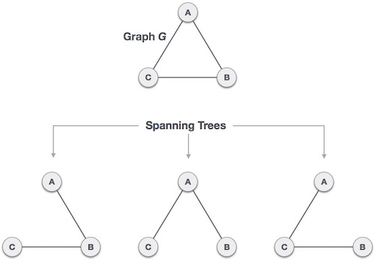
Spanning tree of a graph
Definition: Let G be a connected graph, a spanning sub-graph of G which is tree is called spanning tree.

Slide 10
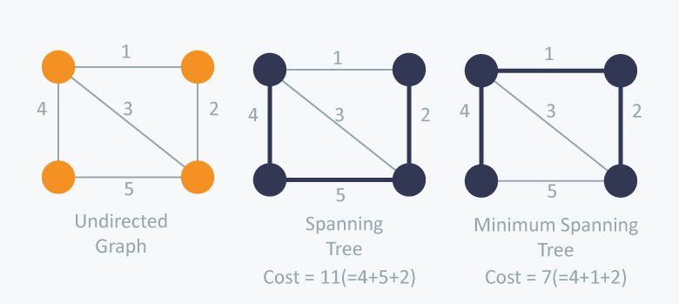
Minimum Spanning Tree
Minimum Spanning Tree: Spanning tree with minimum weight Is known as minimum spanning tree.

Slide 11
Unit IV : Trees
Algorithms to Find minimum spanning tree:Prim’s And Kruskal
1.Kruskal’s Algorithm :
List all the edges of a graph ‘G’ in non-decreasing order of weights of edges.
Select the edge having minimum weight from the list and add it to the spanning tree (which is initially empty), only if the inclusion of the edge does not make a circuit otherwise selected edge is rejected.
Repeat step 2 for the remaining edges in the sorted list until (v-1) edges are included in tree or the sorted list of edges is empty.
If the tree contains less than v-1 edges and the sorted list of edges is empty then display “No MST possible” otherwise print MST .
Example: Refer class notebook

Slide 12
Unit IV : Trees
2.Prim’s Algorithm :
Let G = (V, E), where V is set of vertices in a graph & E is the set of edges in a graph G
Let T = (A, B), where T is a tree, A is a set of vertices in T and B is set of edges in T. Initially A = B = Ø
Let any vertex i Є V be a starting vertex, A = {i}
Find an edge (u, v) Є E such that
u Є A and v Є (V-A) and
weight of (u, v) is minimum
A = A U{v}, B = BU{(u, v)}, delete (u, v) from E
Repeat step 4 until A != V
Print MST .
Example: Refer class notebook

Slide 13
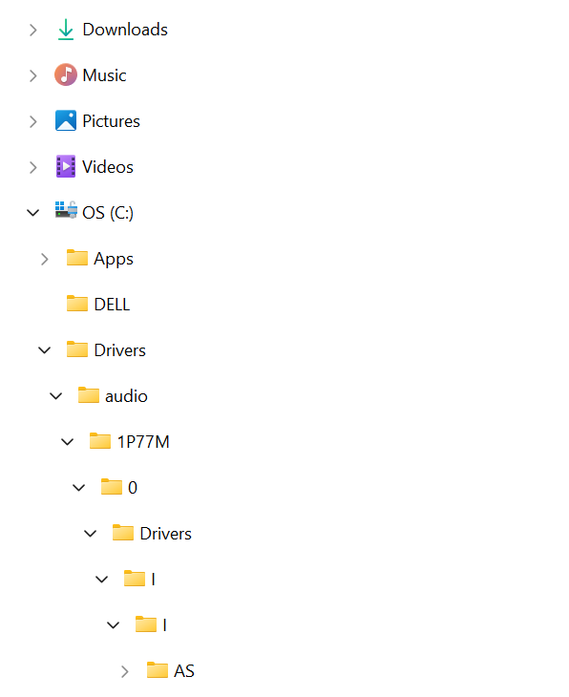
Application of Trees :
Application of Tree Data Structure
File system:
The files and folders that you see in your windows explorer are stored in the tree format. In the below image you can say that ‘My Computer’ is the root; Local Disk (C), Local Disk (D), and Local Disk (E) are basically the parent nodes and files inside them are leaf nodes. This allows faster traversal of the nodes while jumping from one node to another.

Slide 14
Unit IV : Trees
Unit IV at a Glance:
Introduction : Why we need to study Trees?
Basic Terminology: tree, forest, leaf node, branch node, rooted tree, path, path length, height of tree, ordered tree, m-ary, regular m-ary, full m-ary, complete m-ary tree, binary tree
Properties of trees : unique path, e = v-1, at least 2 leaf nodes for trees with >= 2 vertices
Prefix codes : used in communication, Huffman code

Slide 15
Unit IV : Trees
Unit IV at a Glance contd…:
Spanning trees : branches, chords or links
Minimam Spanning Tree : Applications, Kruskal’s algorithm, Prim’s algorithm

